Slide 1
Journal Club Presentation
By Felix Syn
8/8/2025

Slide 2
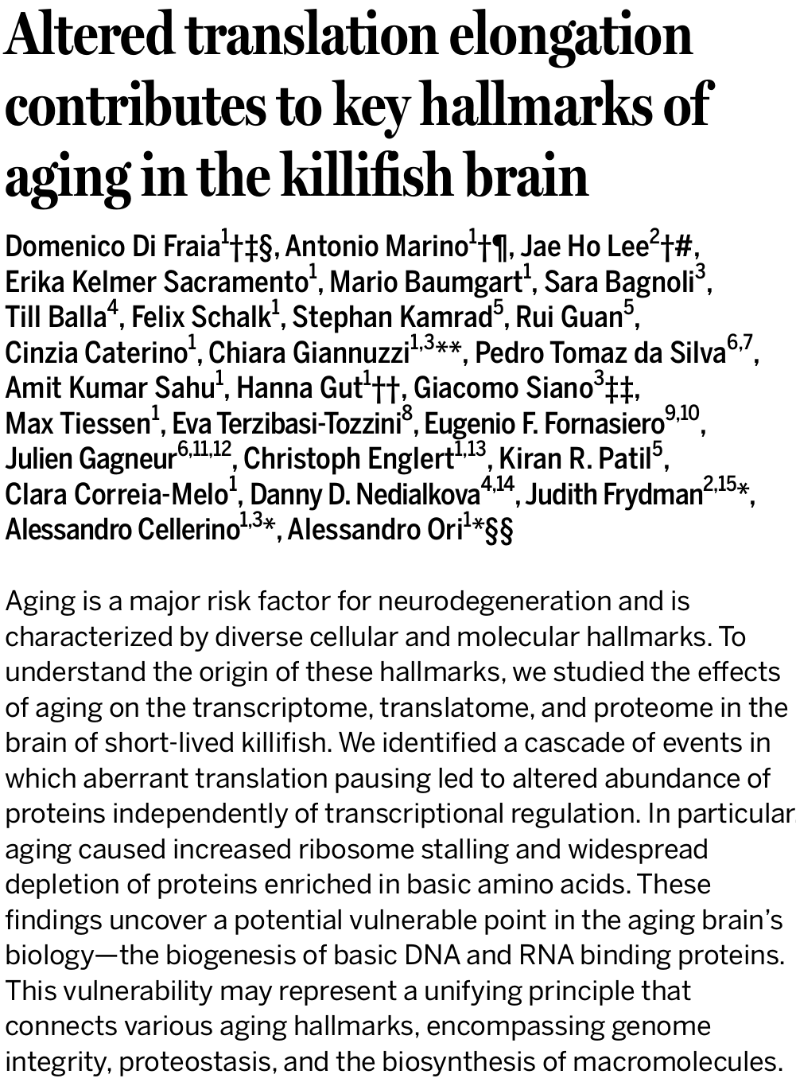
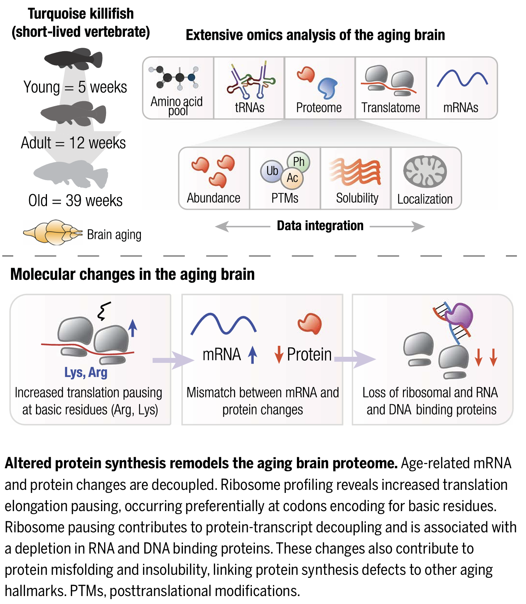

Notes:
Good afternoon, today I will be presenting this paper from Science “”.

Slide 3
Overview
Aging & Decoupling
Linking Decoupling and Proteome changes
Proteasome inhibition on brain proteome
Translation Pausing
How Pausing might occur
Notes:
This paper is content heavy so to give a brief overview…I will introduce aging and the decoupling phenomenon, followed by how decoupling is linked to proteome changes. Next we inhibit the proteasome to simulate aging, then propose translation pausing as a potential cause for decoupling.

Slide 4
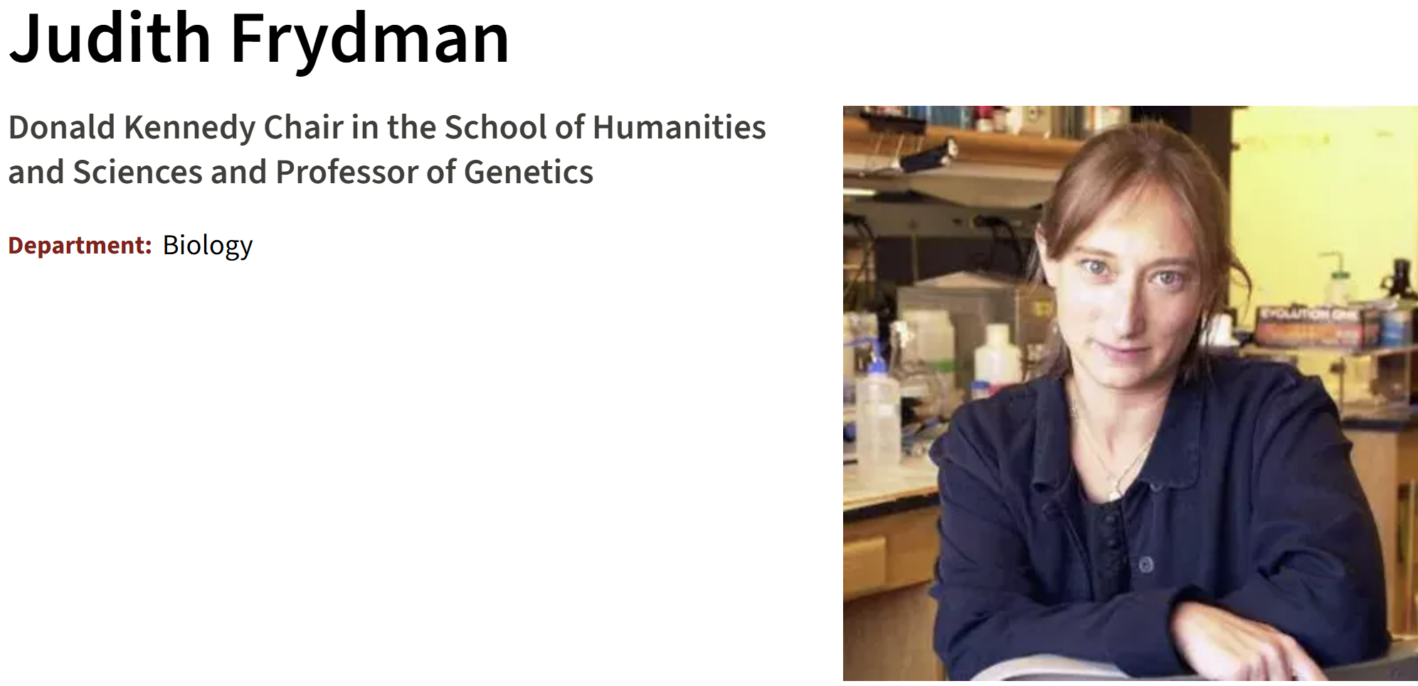
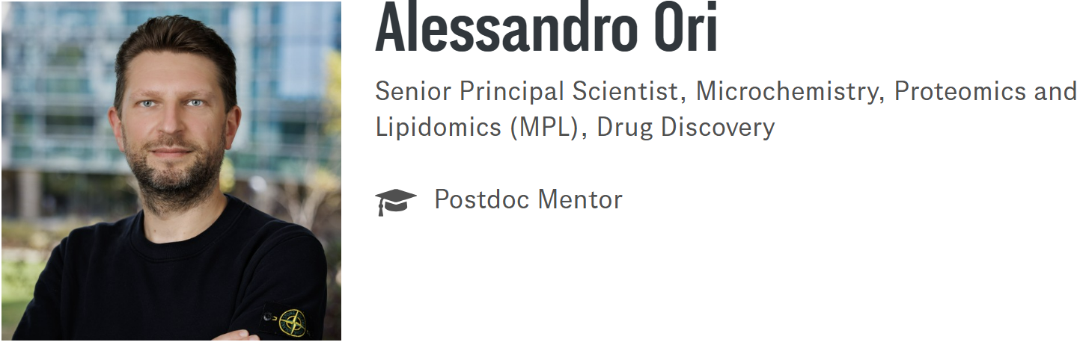
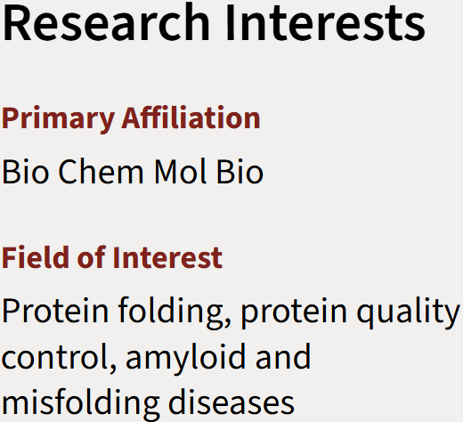



Aging & Decoupling
Linking Decoupling and Proteome changes
Proteasome inhibition on brain proteome
Translation Pausing
How Pausing might occur
Notes:
To start, aging is characterised by diverse cellular and molecular hallmarks from loss of telomeric degradation to changes in the proteome. This paper mainly looks at decoupling as a hallmark of aging by using the turquoise killifish, first established as a model organism for aging by Alessandro Cellerino. It is used throughout this paper for its relatively short lifespan (~3-9 months) and displays many hall marks of mammalian aging. To understand decoupling, we return to the central dogma of biology.

Slide 5
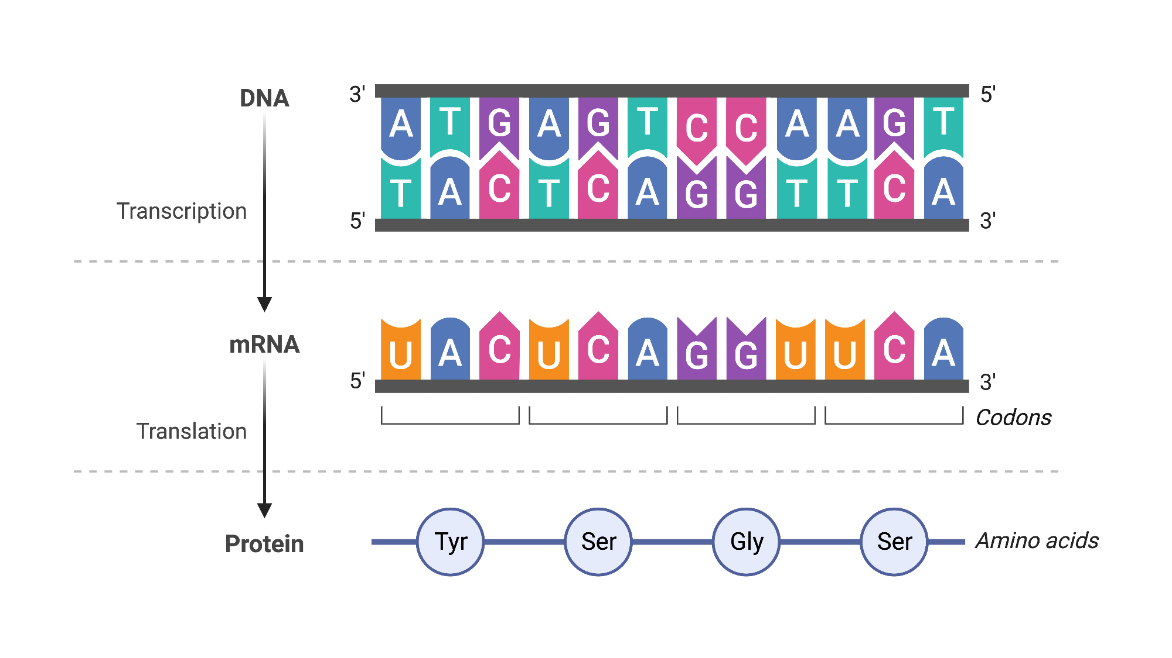
Aging & Decoupling
Linking Decoupling and Proteome changes
Proteasome inhibition on brain proteome
Translation Pausing
How Pausing might occur

Slide 6
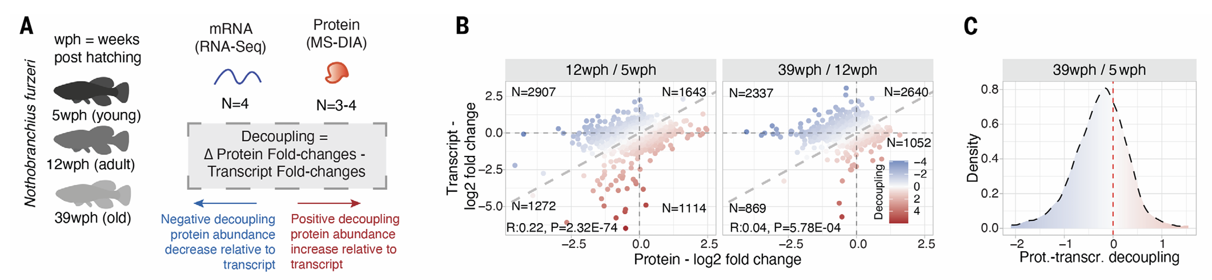
Protein-Transcript Decoupling
Aging & Decoupling
Linking Decoupling and Proteome changes
Proteasome inhibition on brain proteome
Translation Pausing
How Pausing might occur
Decoupling Score (between young & old)
Positive Decoupling
Negative Decoupling
Fig 1
Notes:
To simplify, protein synthesis begins with the transcription of DNA to produce mRNA transcripts that are then processed before getting translated into proteins. This means up or downregulation of the transcript results in the corresponding change in protein levels. Protein Transcript Decoupling refers to the phenomenon of deviating from this relationship that occurs with aging. A decoupling score quantity was made to quantify the degree of the decoupling. Negative decoupling (-ve score) is defined as having lower protein levels than we expect from a relative abundance of corresponding transcripts and vice versa for positive decoupling(+ve score). A biological explanation is needed here.

Slide 7
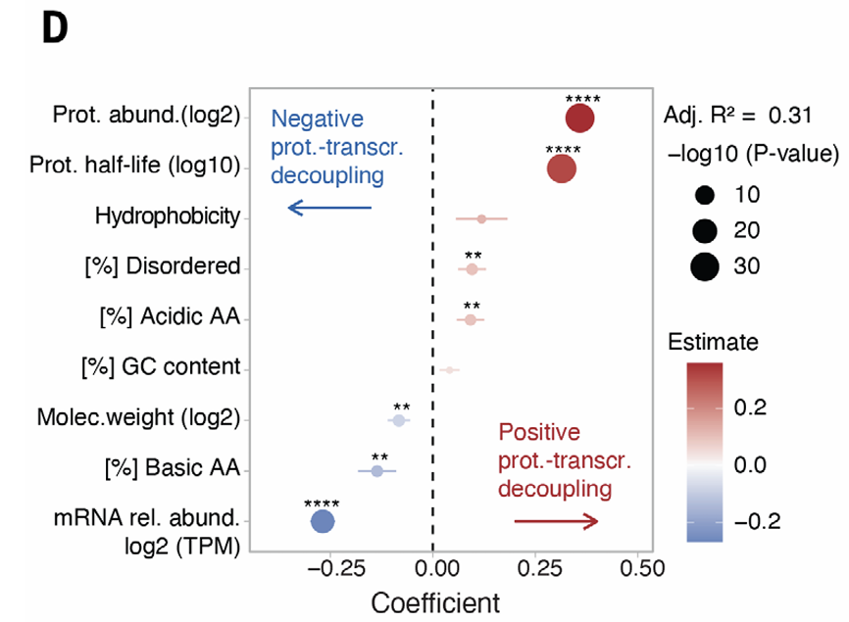
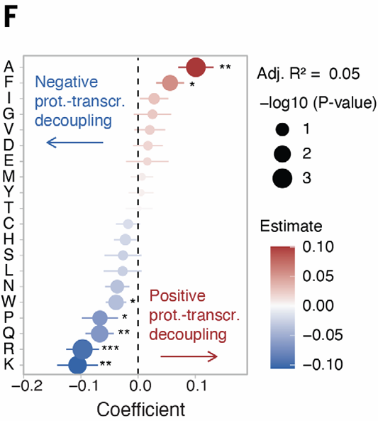
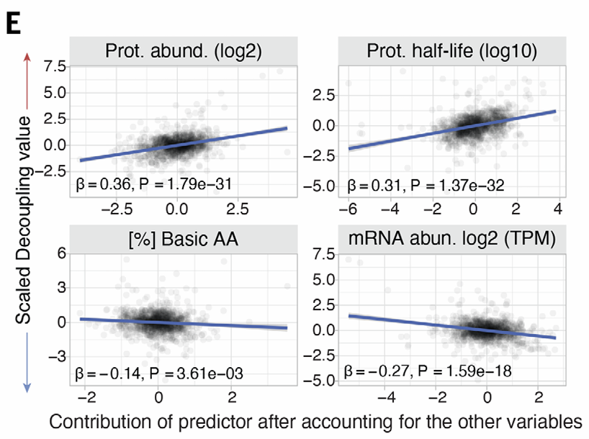
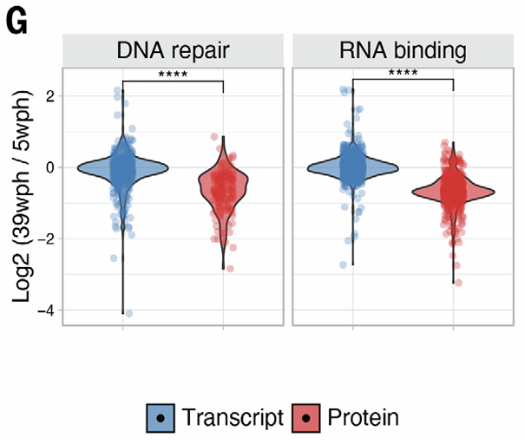
Regression Analysis with Decoupling
Aging & Decoupling
Linking Decoupling and Proteome changes
Proteasome inhibition on brain proteome
Translation Pausing
How Pausing might occur
Biophysical properties
Amino Acid composition
(mouse)
Fig 1
Notes:
Di Friai et all began with a regression analysis to understand how decoupling affects certain properties such as Biophysical properties, individual AA composition and Myelin Components. These show the correlation with decoupling for each property (D+E & F). Interestingly, proteins involved in RNA binding and DNA repair (more basic AA) had age related decrease in protein levels despite basically no change in transcript level (G & H). The converse was true for myelin components with reduced transcript levels but higher protein levels.

Slide 8
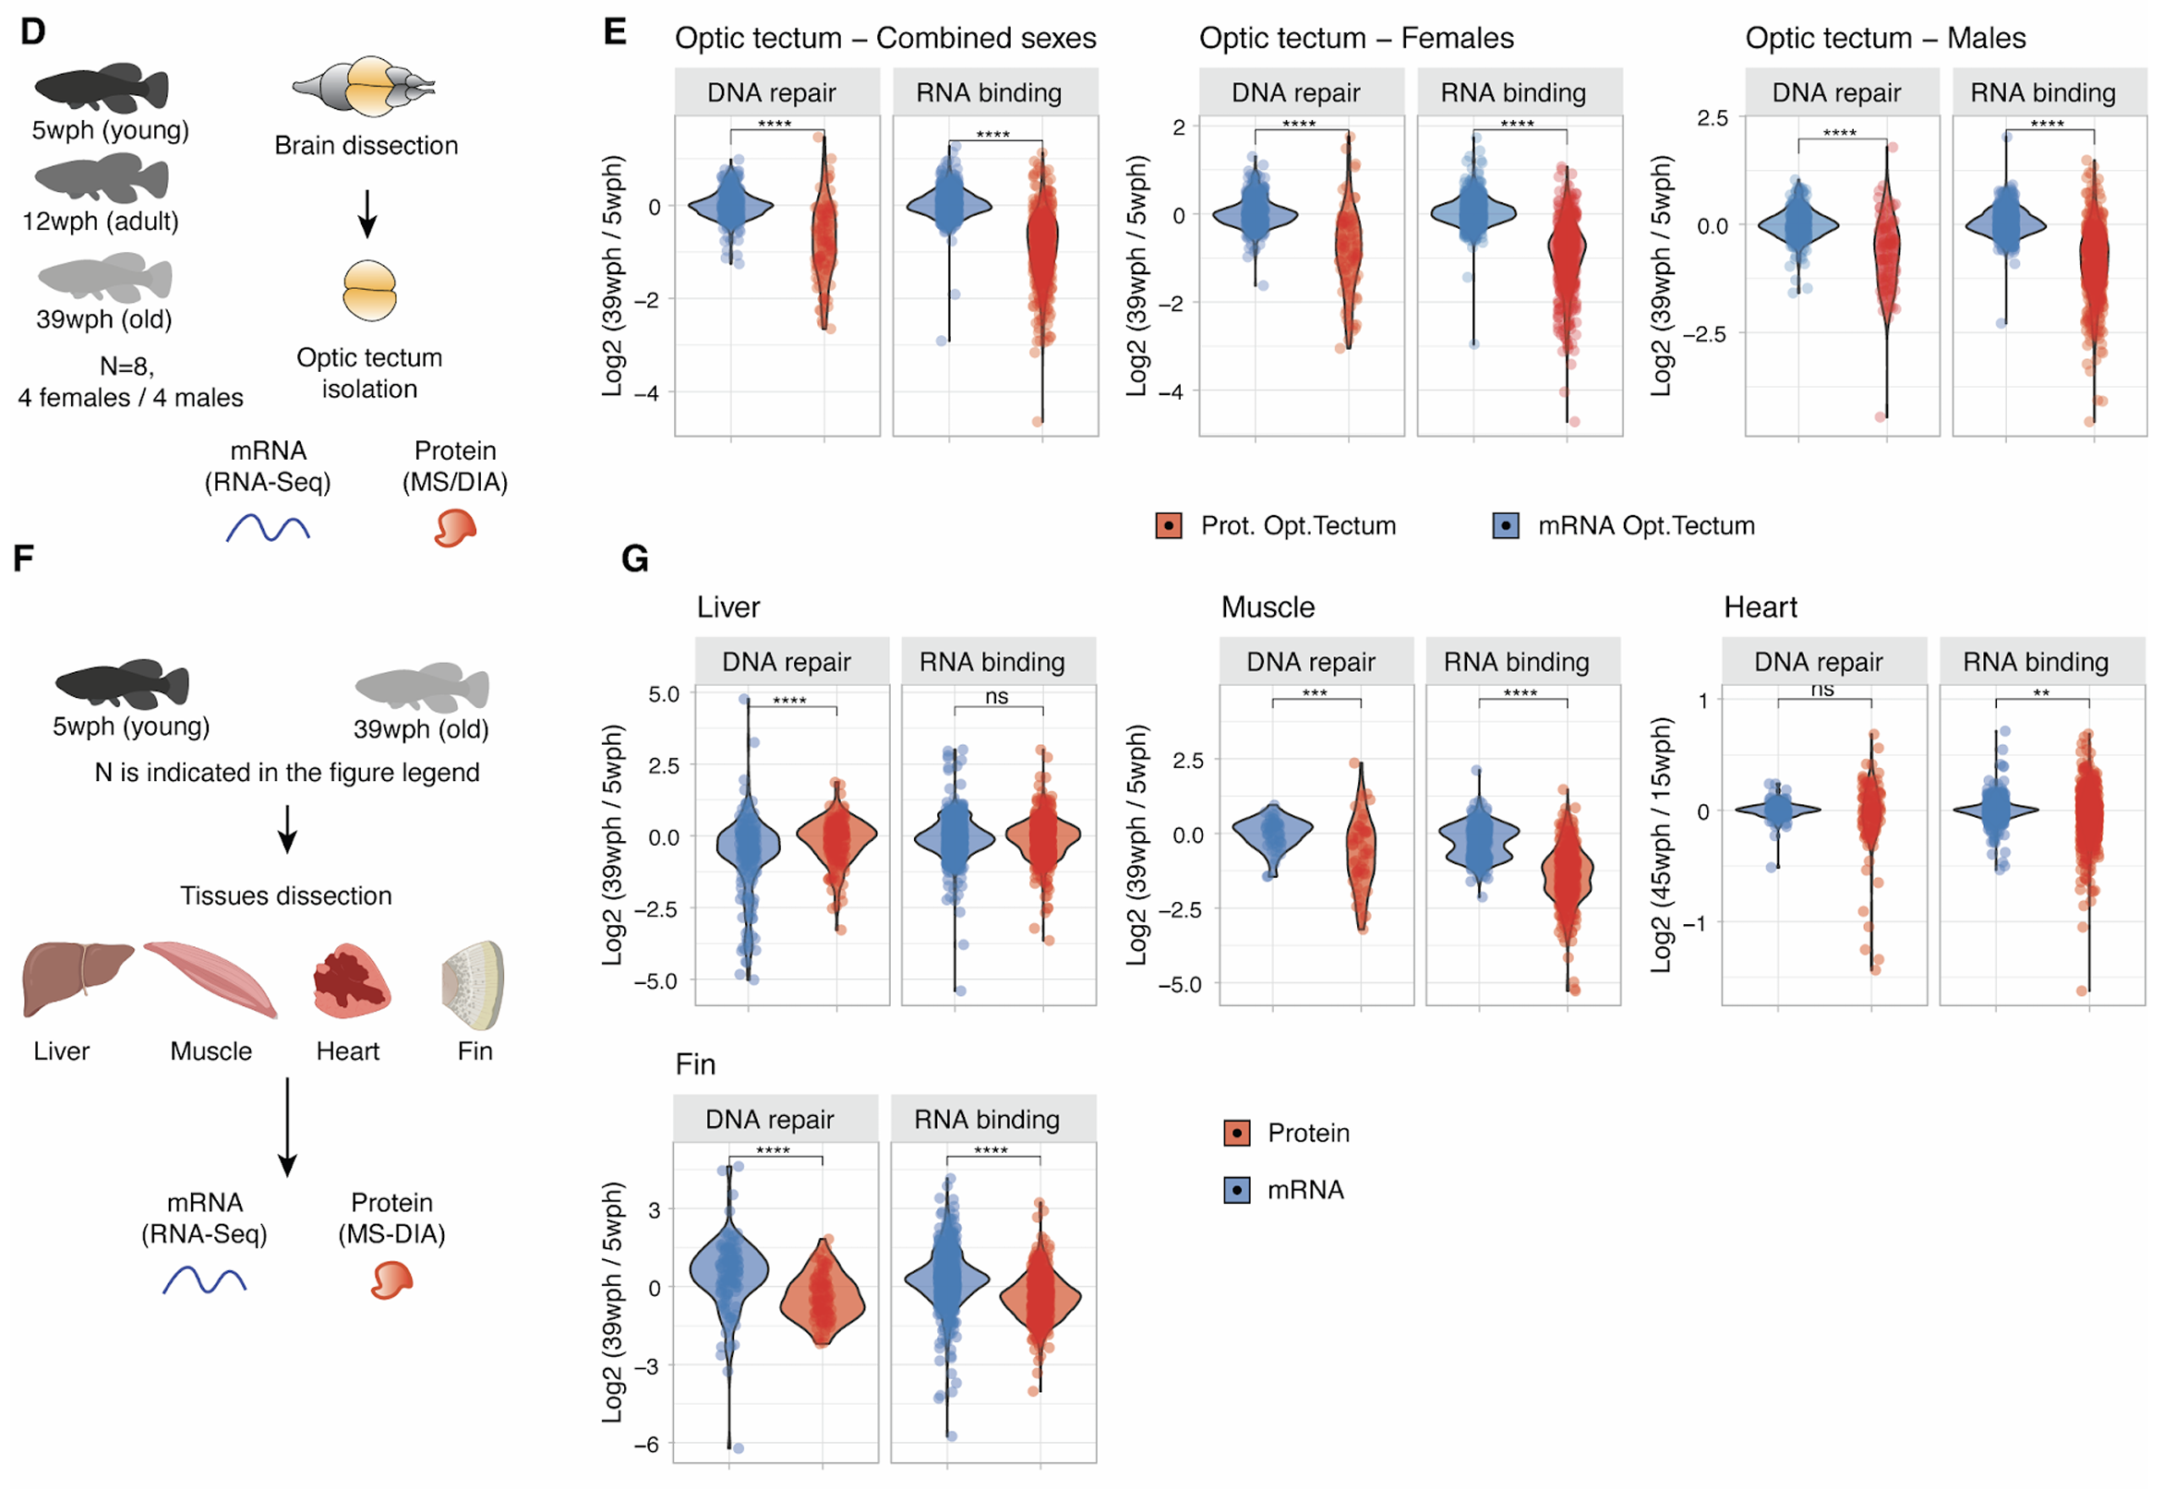
Sex dependence? Nope
Aging & Decoupling
Linking Decoupling and Proteome changes
Proteasome inhibition on brain proteome
Translation Pausing
How Pausing might occur
Aging results in sex independent transcript and protein changes in the brain
Fig S2
Notes:
The analysis was repeated to show that aging can lead to sex independent transcript and protein changes, not just in the brain but other organs as well with some variation. Both sexes have similar levels of decoupling and they also looked at 4 other organs. The muscle and Fin had the most protein downregulation and –ve decoupling followed by the heart and none in the liver

Slide 9
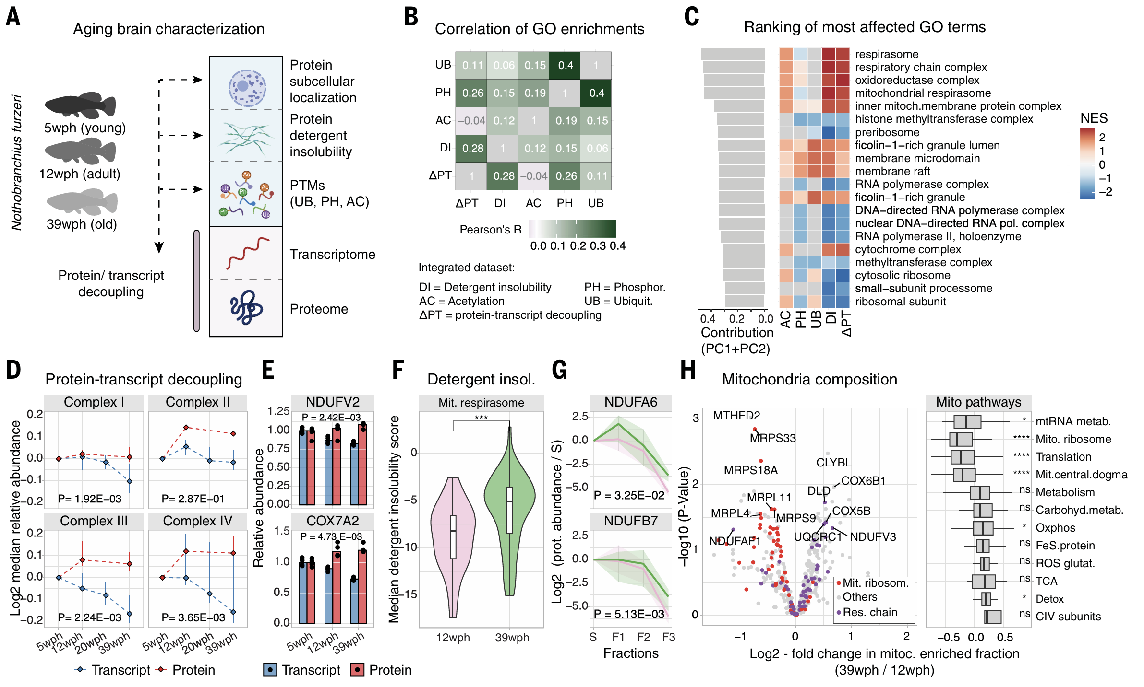
Aging & Decoupling
Linking Decoupling and Proteome changes
Proteasome inhibition on brain proteome
Translation Pausing
How Pausing might occur
Subcellular Fractionation + MS
(Protein Solubility)
Differential Detergent Extraction
Enrichment + MS
Notes:
Now that decoupling has been established, Next, links between decoupling and 3 specific proteome alterations were explored. Protein subcellular localisation, Protein Solubility and Post Translational Modifications associated with neuronal physiology (A)

Slide 10
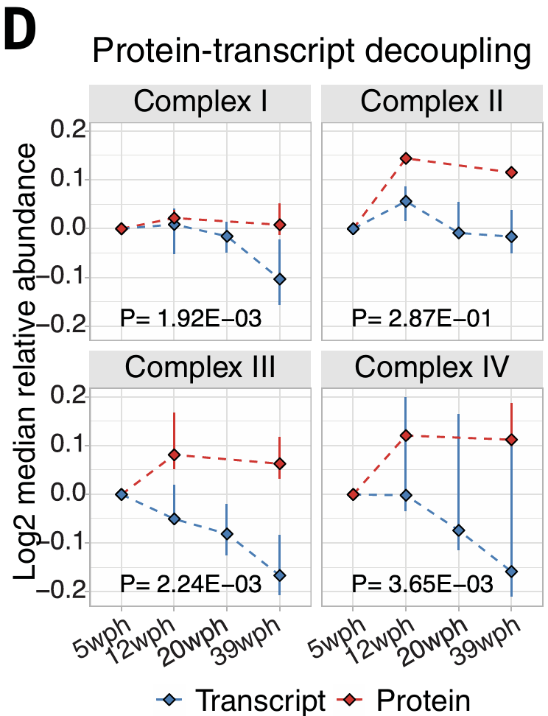
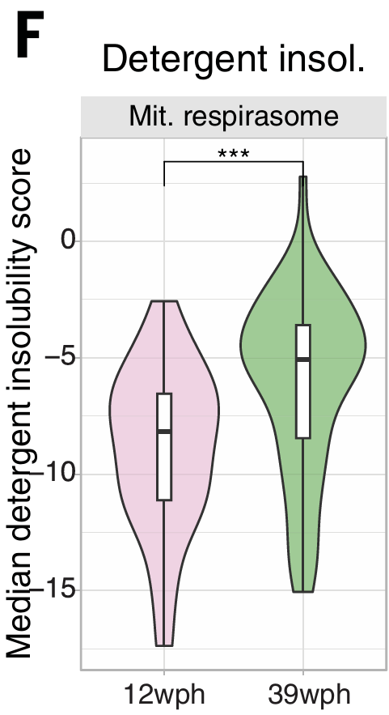
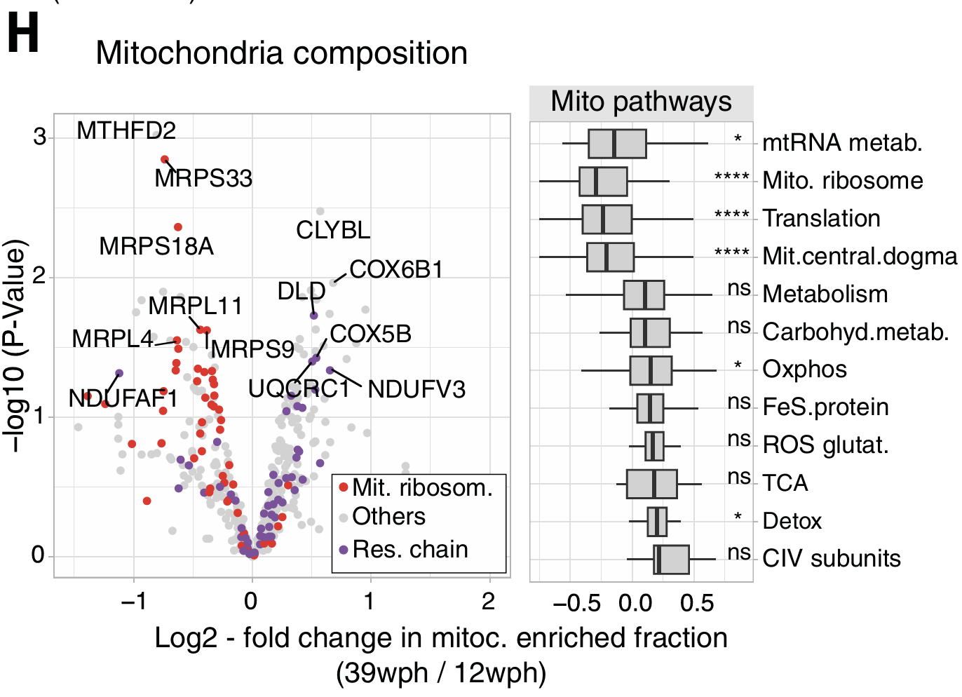
Aging & Decoupling
Linking Decoupling and Proteome changes
Proteasome inhibition on brain proteome
Translation Pausing
How Pausing might occur
Gene Set Enrichment Analysis
PCA on enrichment scores
Mitochondrial Respiratory Chain Components
(Mitochondria, Ribosomes, RNA polymerases)
Detergent Insolubility & Phosphorylation PTM correlated most with decoupling
Mito. Resp Chain & ribosomal proteins affected most by decoupling
Global mitochondrial remodelling with aging
Fig 2
Notes:
Now that decoupling has been established, Next, links between decoupling and 3 specific proteome alterations were explored. Protein subcellular localisation, Protein Solubility and Post Translational Modifications associated with neuronal physiology (A). Gene Set Enrichment Analysis, a computational method to compare 2 states of a set of genes was used, resulting in Detergent Insolubility showing the strongest correlation followed by phosphorylation (B). Mitochondrial Respiratory chain components were affected most by decoupling(C). They also showed a relatively steady protein level despite decreasing transcript levels during aging (D+E). Detergent insolubility of Mito. Resp chain proteins increased (F+G). Change in composition of mitochondria with fewer mito ribosomes but more Oxidative Phosphorylation (H). This supports global remodelling of the mitochondrial proteome in aging. 12 & 39 wph data was used to account for killifish growth

Slide 11
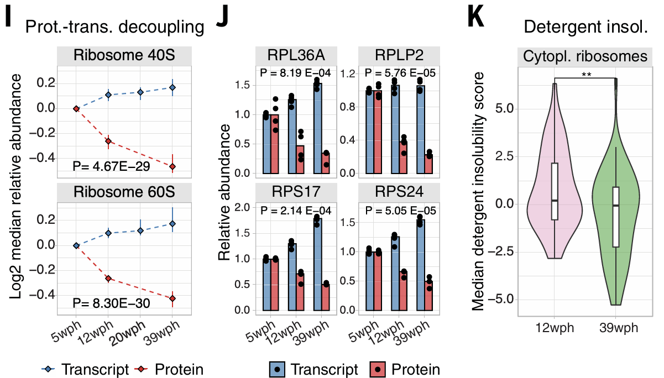
Aging & Decoupling
Linking Decoupling and Proteome changes
Proteasome inhibition on brain proteome
Translation Pausing
How Pausing might occur
Aging mainly affects mitochondrial proteins, ribosomes and DNA/RNA binding proteins differently
Independent of mRNA transcript changes
Could result from post-transcriptional mechanisms
Fig 2
Notes:
Cytosolic and Mitochondrial ribosomal proteins decreased with aging with –ve decoupling (I+J). There was also decreased detergent insolubility (K). Altogether we show that…

Slide 12
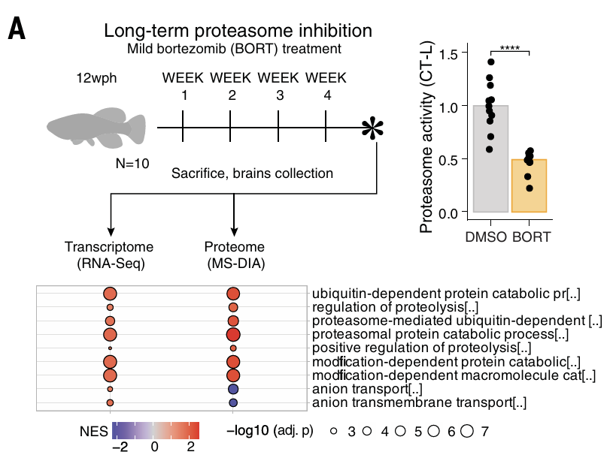
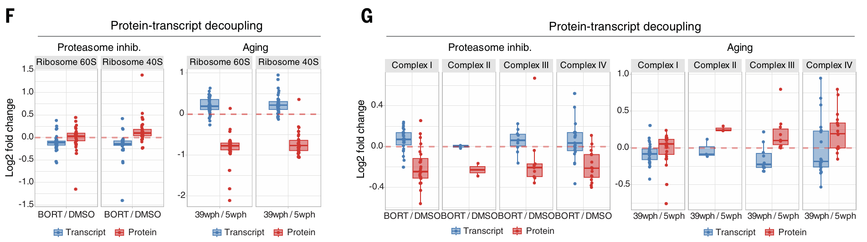
Aging & Decoupling
Linking Decoupling and Proteome changes
Proteasome inhibition on brain proteome
Translation Pausing
How Pausing might occur
Proteasome inhibition
Bortezomib v DMSO weekly injections for 4 weeks on adult killifish (12wph)
Proteasome doesn’t solely account for proteostasis decline in aging
Opposite Decoupling!
Fig 3
Notes:
Aging is associated with proteasome activity decline. The proteasome was inhibited by weekly Bortezomib injections for 4 weeks (A). There were adaptive responses to proteasome inhibition such as upregulation of proteasome activators and key autophagy genes as a proteostatic response (B). Lysosomal morphology changes (C) and reduced mitochondrial content (D). But then opposite decoupling was observed for ribosomal proteins and mitochondrial respiratory chain complexes between proteasome inhibition and aging so proteasome decline does not solely account for the decline in proteostasis found in aging. Proteasome inhibition also cannot mimic significant aging hallmarks.

Slide 13
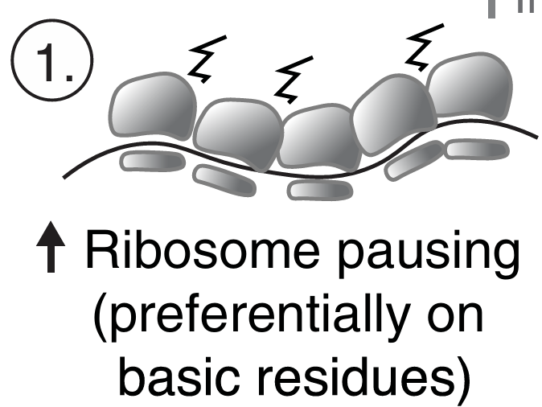
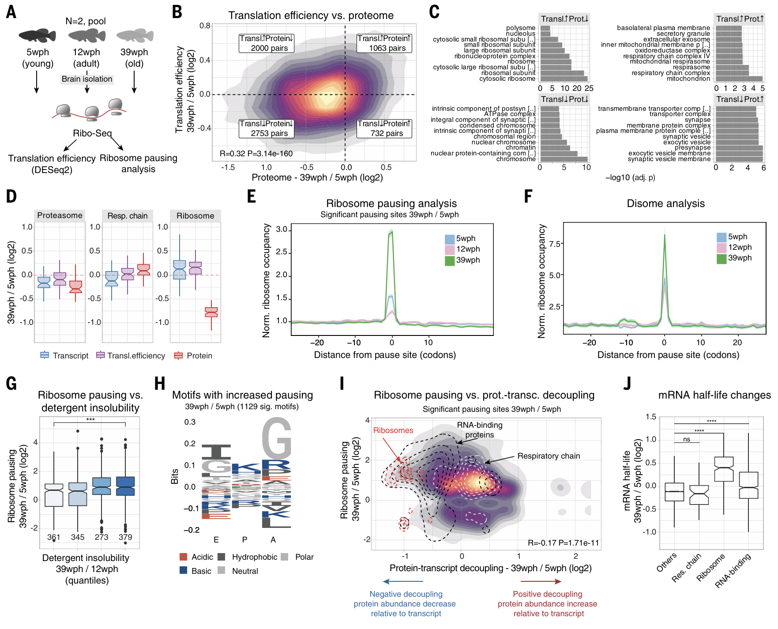
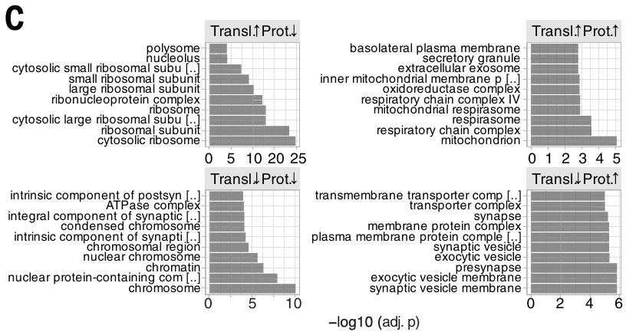
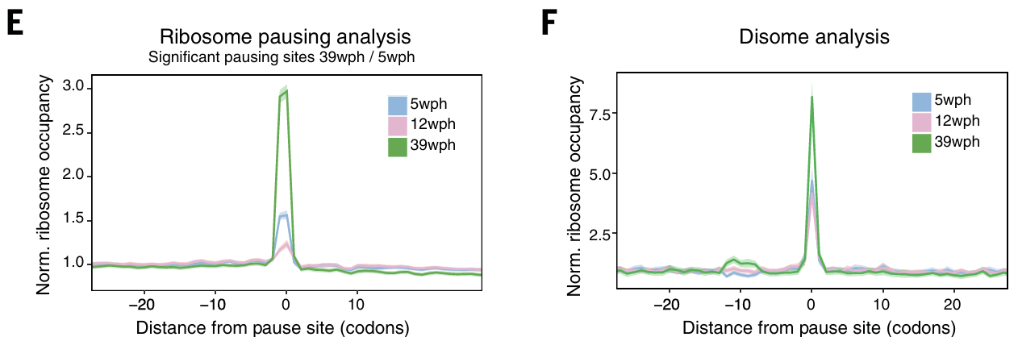
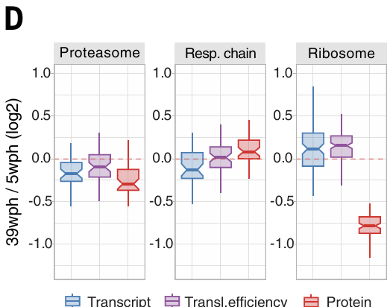
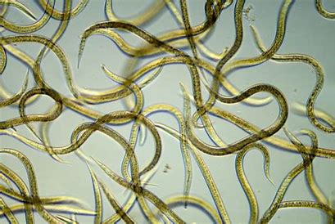
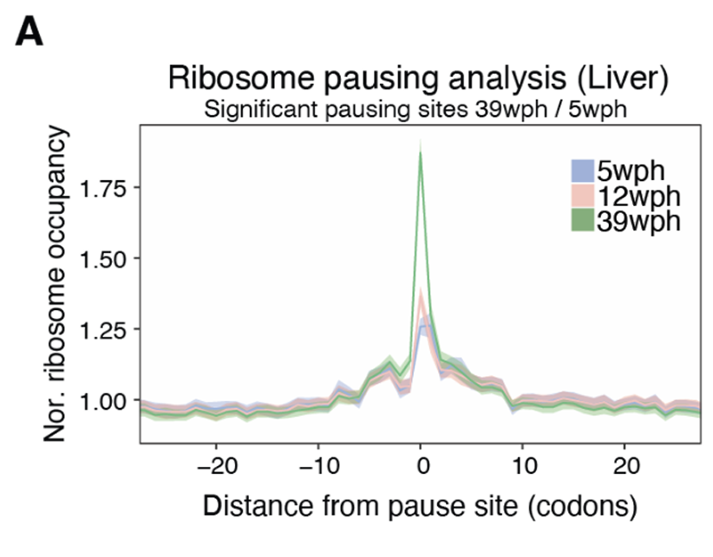
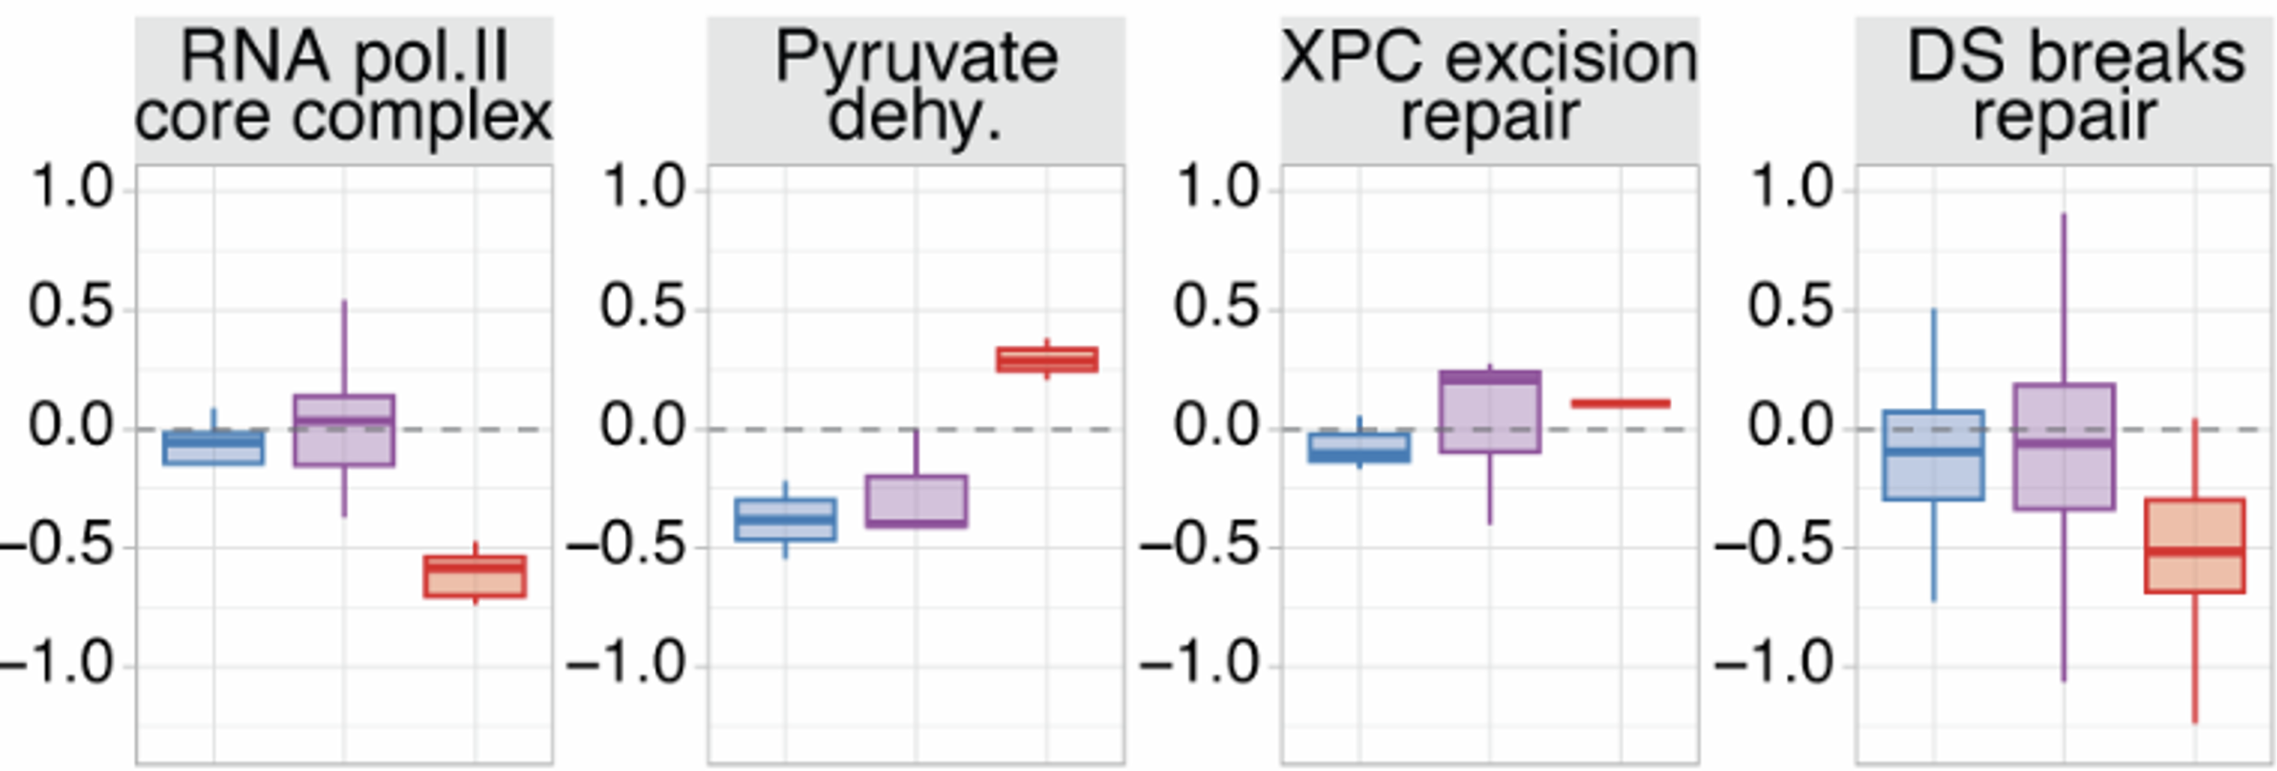
Aging & Decoupling
Linking Decoupling and Proteome changes
Proteasome inhibition on brain proteome
Translation Pausing
How Pausing might occur
Translation Efficiency
Ribosome Pausing
(Ribosome Collisions)
(Not output/input)
Nematodes
Fig S11
Fig 4
Notes:
Differential mRNA translation with aging could be another factor. Ribo-seq on killifish brains was used to evaluate Translation Efficiency (A). TE shifts resulted in in consistent changes for many proteins (C) but couldn’t explain reduced protein levels in ribosomes, RNA pol2 and DNA/RNA binding proteins(D), so TE is excluded as a cause of this decrease in proteins. Inspired by age related impaired translation elongation and ribosome pausing in aged nematodes and yeast, Ribo-seq data was used to find related signatures. Increased site specific pausing (E) Increased ribosome collisions (F) and similarly in liver but to lower extent(Fig S11A). Translation Efficiency is just the ratio of ribosome protected fragments to total mRNA fragments but calculated with DESeq2 R package.

Slide 14
Aging & Decoupling
Linking Decoupling and Proteome changes
Proteasome inhibition on brain proteome
Translation Pausing
How Pausing might occur
(More basic AAs)
Ribosome pausing may underlie the decreasing abundance of ribosomal & binding proteins in aging brains
Fig 4
Notes:
More translation pausing = More detergent insolubility, suggesting more aggregation (G). Basic amino acids (Arginine and Lysine) were enriched at each of the ribosome’s sites(Aminoacyl, Peptidyl, Exit) (H) that we previously found to be associated with reduced protein abundance with age. Correlation between ribosome pausing and decoupling may explain why ribosomes(red dash) and RNA binding proteins (black dash) levels don’t follow transcript level changes while Respiratory chain proteins (white dash) don’t deviate from overall pausing distribution (I). Ribosomal and RNA-binding proteins show higher mRNA half-life in old age than other proteins so they are more stable (J).

Slide 15
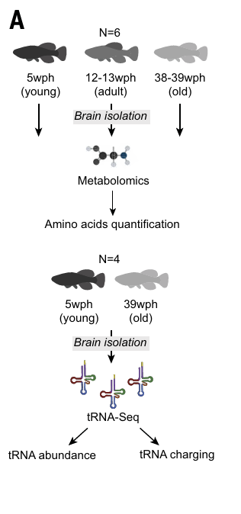
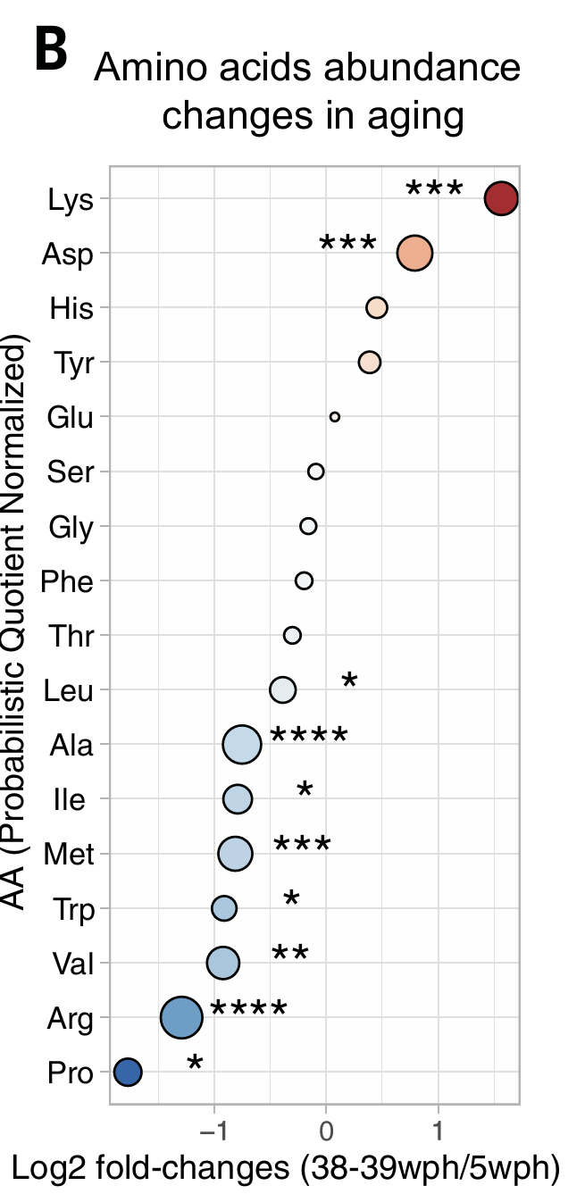
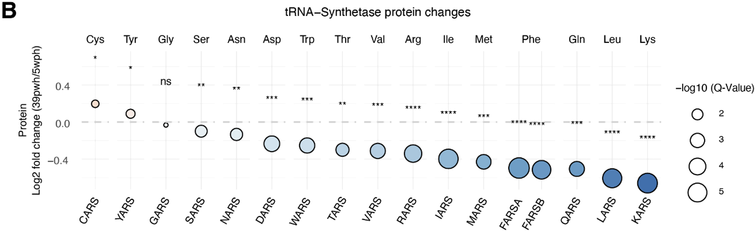
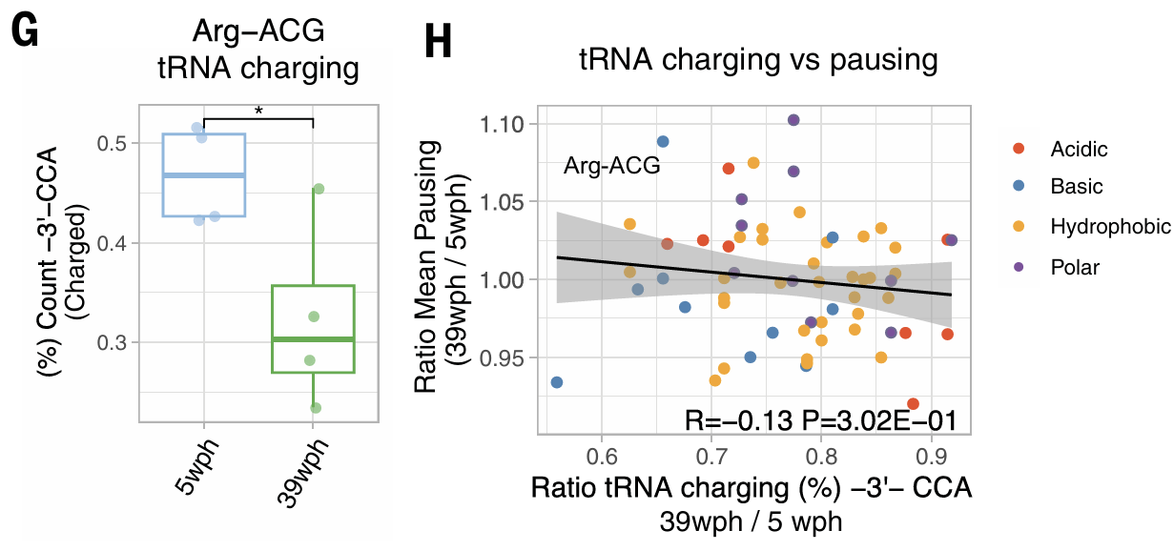
Aging & Decoupling
Linking Decoupling and Proteome changes
Proteasome inhibition on brain proteome
Translation Pausing
How Pausing might occur
Fig S12
Total Abundance Unchanged
Decreased tRNA synthetase levels in old brains
Decreased tRNA charging may contribute to ribosome pausing
Fig 5
Notes:
To dive into the pausing mechanism, they examined how metabolic changes affect AA abundance and whether aging affects the abundance and charging of tRNAs. It was found that most tRNA synthetase levels decreased with age
Multiple AA amounts changed in aging brains (B) but total abundance wasn’t affected (E). Finally tRNA charging globally decreased with aging. Changes in tRNA charging not correlated with ribosome pausing (H) except for a few like Arg (G). Overall im not entirely convinced by this mechanism.

Slide 16
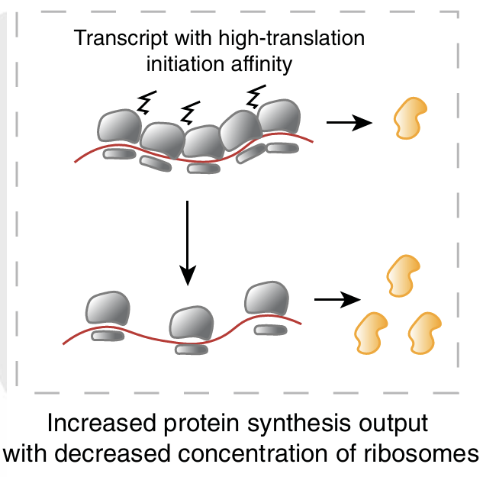
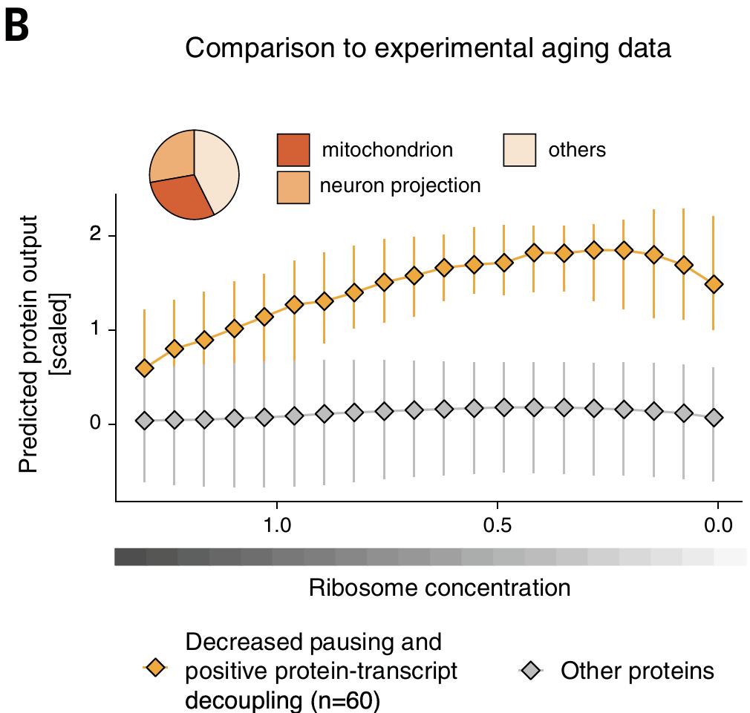
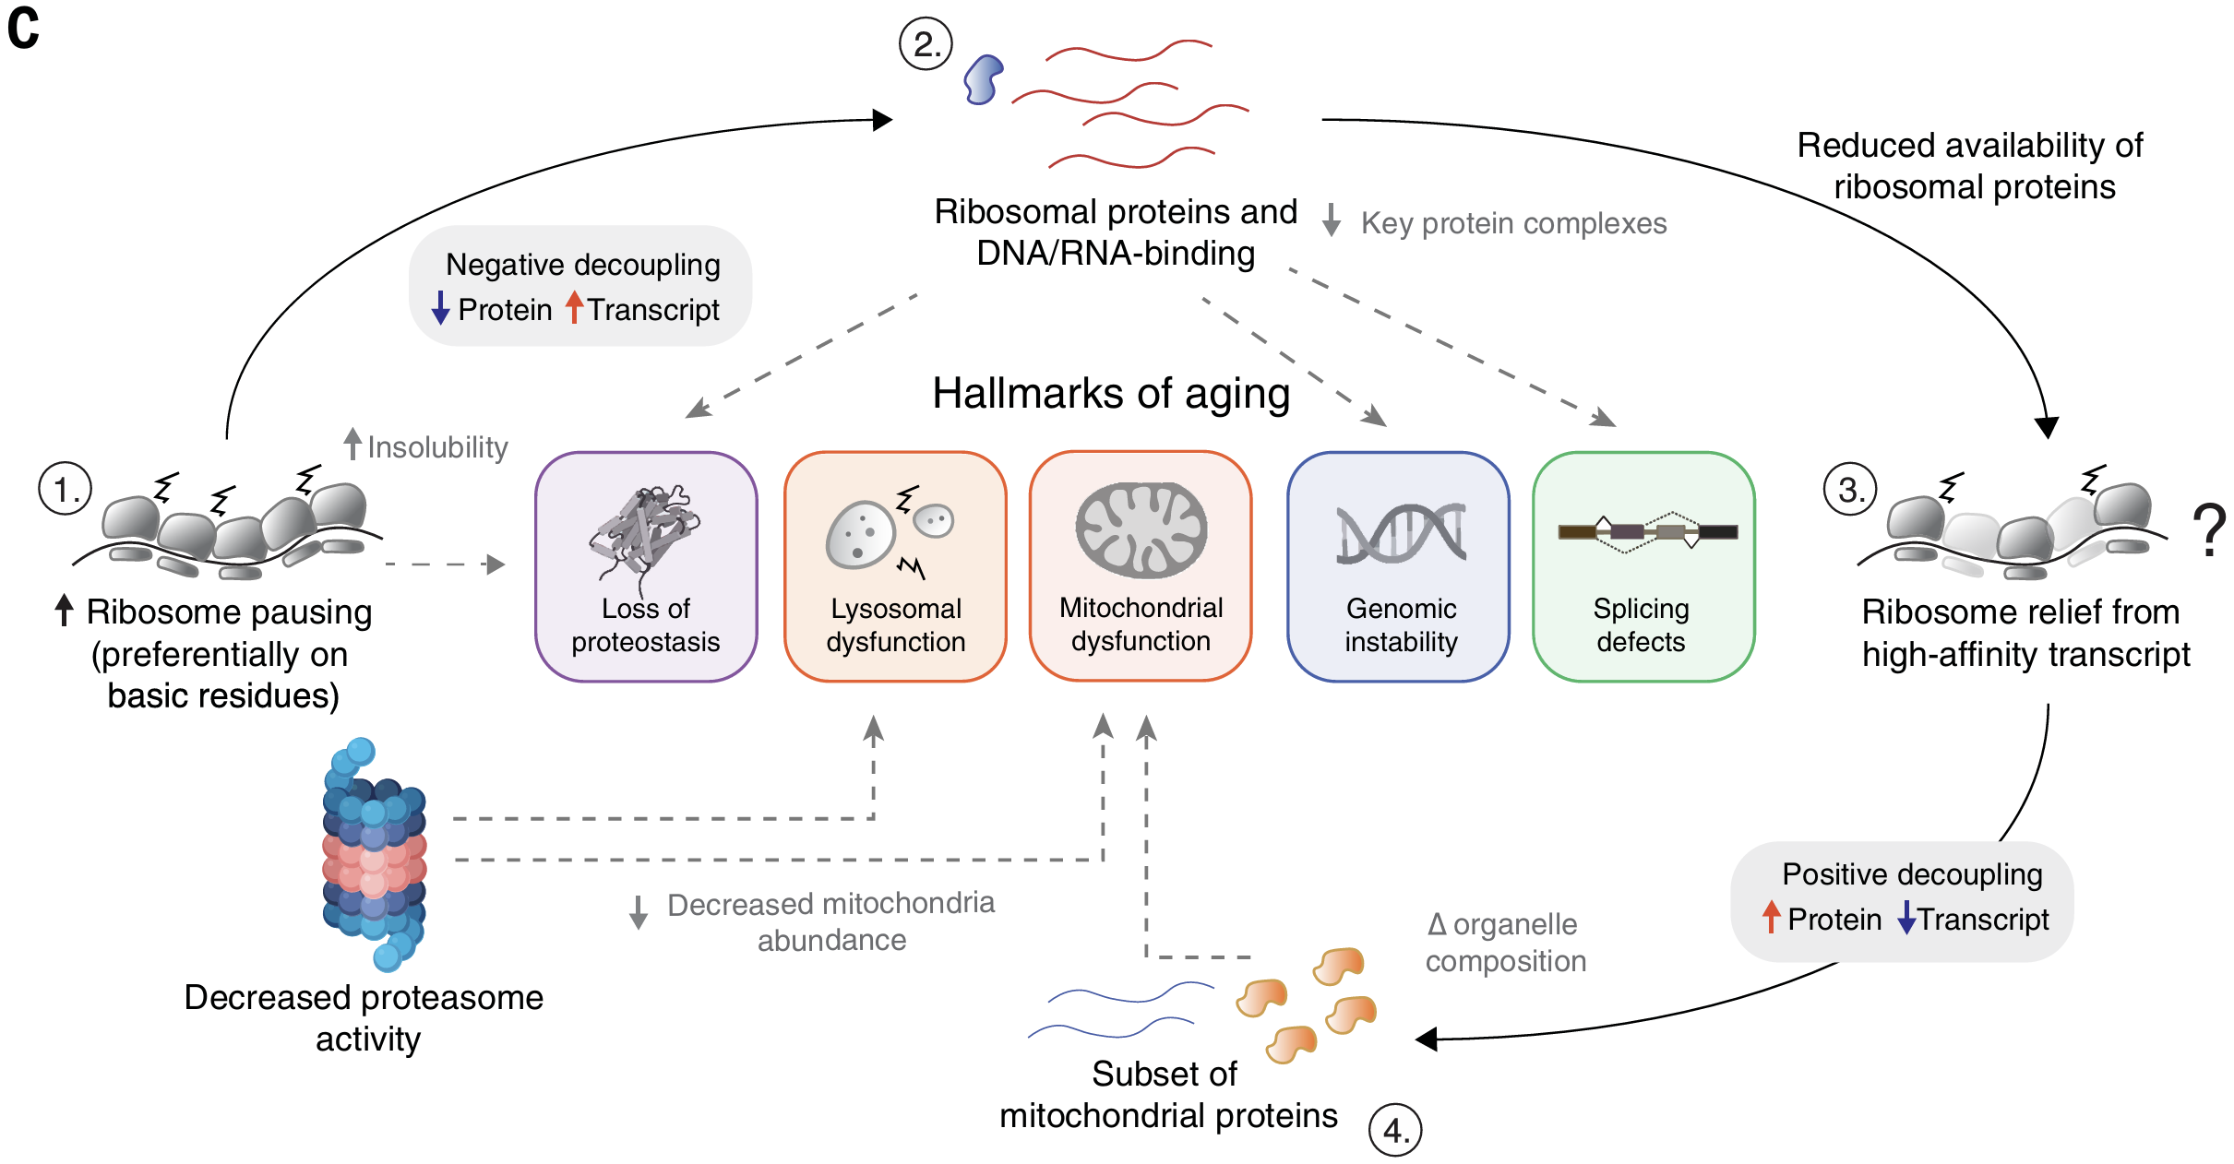
Protein Biosynthesis Model
Mass Spectrometry
Fig 6
Notes:
Knowing that old brains produce fewer ribosomal proteins, perhaps there are fewer ribosomes which could result in fewer ribosome collisions (A) and an increase in translation of mRNA transcripts with a high translation initiation rate(B). This might cause protein level changes to be decoupled from transcript changes.

Slide 17
Conclusions
More Protein Transcript Decoupling (-ve) occurs with aging
Aging affects mitochondrial, ribosomal and DNA/RNA binding proteins differently independent of mRNA changes
Translation/Ribosomal Pausing likely contributes to decoupling
Higher Translation Pausing results in fewer ribosomes ⇒ protein level changes independent of mRNA transcript changes

Slide 18
Discussion points
Are the age timepoints appropriate and sufficient for reliable data collection? Would more timepoints be beneficial?
To what extent can such killifish aging experiments be transferrable to humans? (Which organs?)
To what extent might reduced tRNA charging and ribosome abundance account for decoupling?
Is there an opportunity for reversing decoupling effects?

Slide 19
Thank You ☺
fini

